Slide 1
Effects of Cord clamping in preterm infants
Joshua Moe, Sonu Ojha, Bryan Quintana, Kel Amede, Nicoletta sheppard

Slide 2


Intro/data fetching

Slide 3
Data process
Dataset consists of 353 rows and 36 columns.
Should ‘died’ or ‘survwithoutmajormorbidity’ be the ‘target’?
Dropped columns 'hct1224' and 'hct1236’ then dropped any rows containing any NaN value(s)—preserved 310 rows of data. (not dropping the two column results in losing over a third of our data).
After cleaning the dataframe, no entries where a subject died remained. Even if we didn’t drop columns 'hct1224' and 'hct1236’, less than 5% of the entries had subjects who ‘died’. Went with ‘survwithoutmajormorbidity’ for a better target split of close to 4/1 (yes/no) ratio.

Slide 4
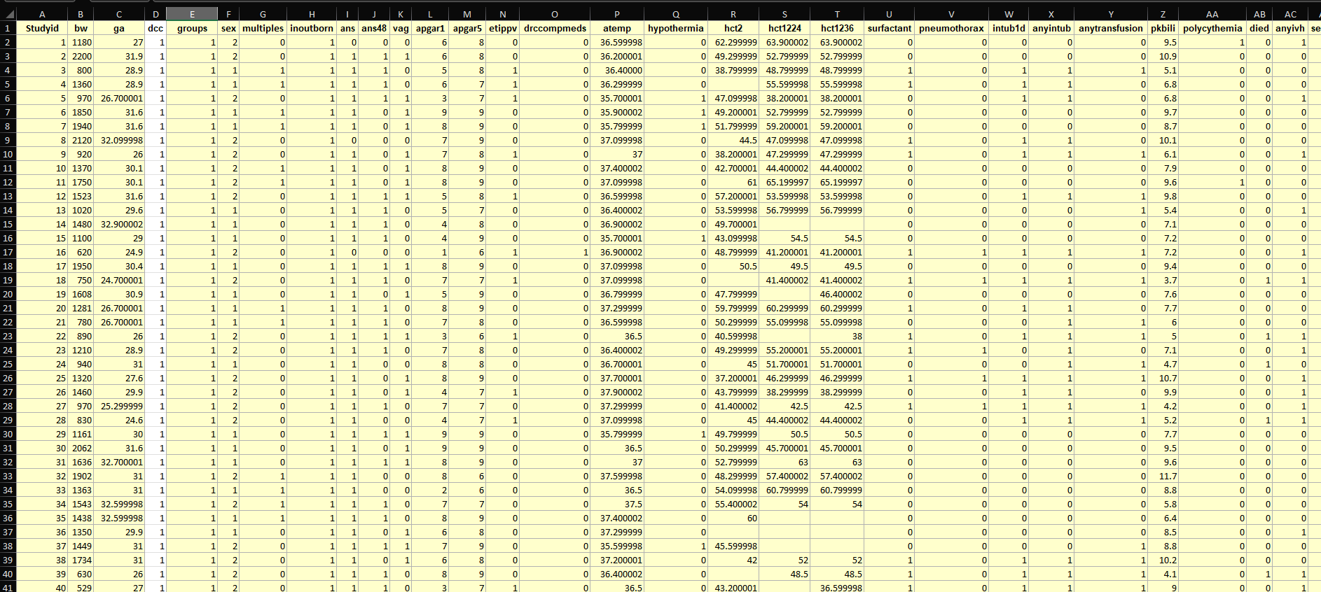
visual

Slide 5
Machine learning model
Logistic Regression Classification Module.
Thirty-Three columns as Features. The ‘survwithoutmajormorbidity’ column as the Target.
Procedure:
Train-test-split the data (after ETL).
Scale the features with StandardScaler().
Create a Logistic Regression model (random_state=1)
Fit the model
Make prediction and Evaluate accuracy of predictions made.

Slide 6
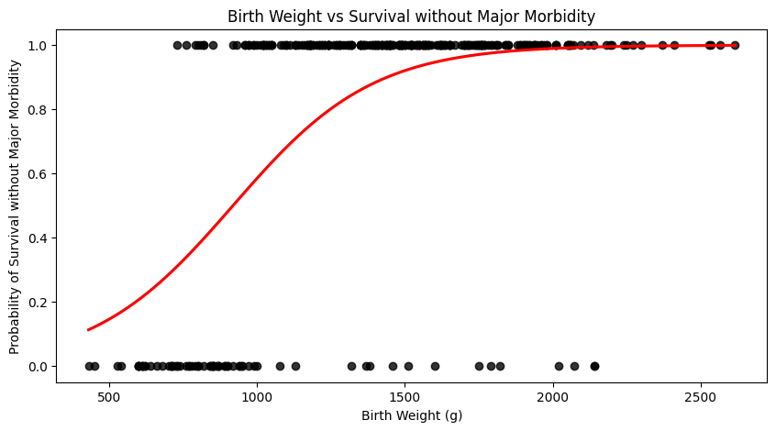
visual
Each black dot represents an individual date point, indicating the birth weight and whether survival without major morbidity
1 = Survival
0 = No Survival
The red curve is a logistic regression model that shows a trend as weight increases, the chances of survival with morbidity also increases

Slide 7
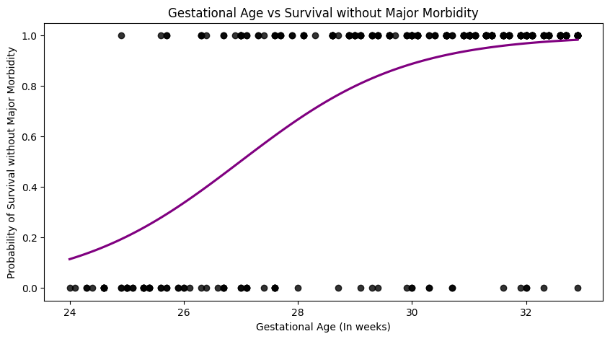
visual
The black dots represent an individual case, plotting gestational age against whether the infant survived without major morbidity
1 = Survival
0 = No Survival
The purple curve is a logistic regression line that demonstrates the upward trend of survival probability with increasing gestational age

Slide 8
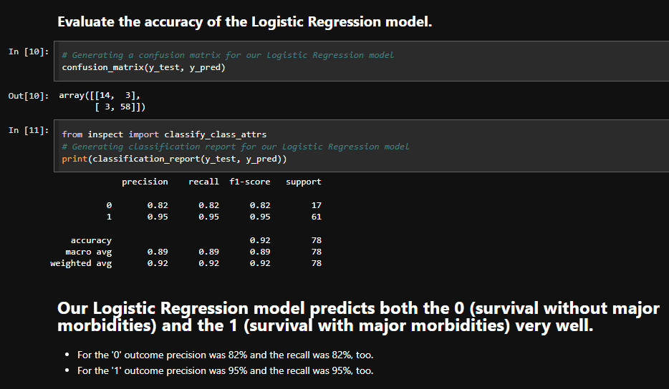
Testing/documentation
Confusion Matrix
Ran code for a confusion matrix that shows how accurate our findings are
Classification Report
Out of all detailed metrics non survival (0) outcomes were predicted at 82% precision and survival (1) outcomes were at a 95% precision the recall was the same as well

Slide 9
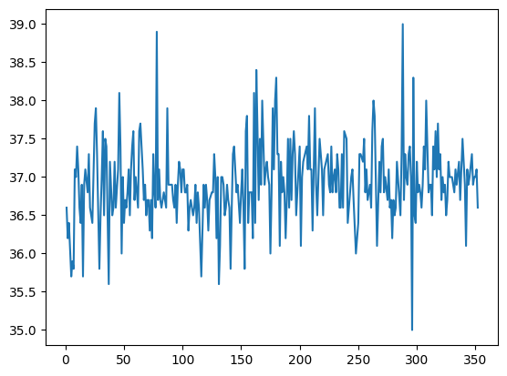
visual
This graph has relationship between each infant and their admission temperature. Infants admitted with temperature less than 36 degree Celsius had hypothermia.
Admission temperature in Celsius
Study Id

Slide 10
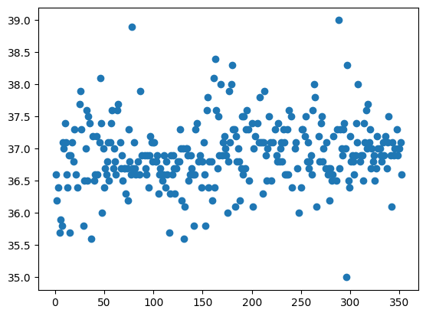
This graph is similar to last slide but it shows the data in scattered form.
Admission temperature in Celsius
Study Id

Slide 11
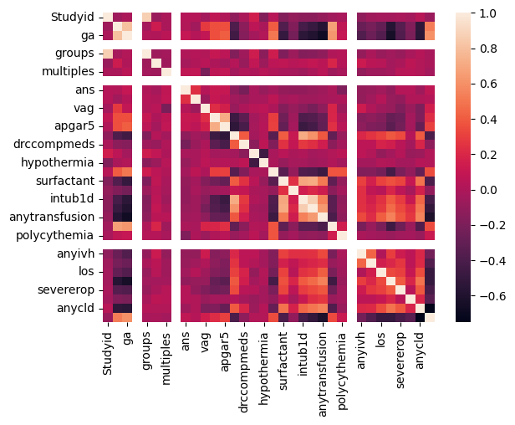
visual
This graph is showing correlation between multiple variables as a color coded matrix. Lighter shade is showing the highest correlation between columns. Darker shade represents lower correlation.

Slide 12

Summary of findings
Health Outcomes Correlated with Timing
Analyzing these correlations can help validate the known benefits of delayed clamping.
Predictive Modeling
Models can be trained to predict the risk of anemia or hemorrhage based on variables such as birth weight, gestational age, and clamping time.
Personalized Recommendations
By analyzing historical data, we can predict which infants might benefit most from delayed cord clamping, enabling clinicians to tailor their approach based on individual risk profiles.
Real-time Decision Support
As new data about an infant becomes available, the model can quickly assess the most beneficial cord clamping timing, supporting clinicians in making informed, evidence-based decisions.

Slide 13
Work cited
Song, Dongli; Jegatheesan, Priya; DeSandre, Glenn; Govindaswami, Balaji (2016). Data from: Duration of cord clamping and neonatal outcomes in very preterm infants [Dataset]. Dryad. https://doi.org/10.5061/dryad.4q3d3

